Slide 1
Are Yelp Reviews Providing Insight to a Restaurant Closing Down?
Exploring customer satisfaction of restaurants and the impact on the a restaurant’s operating status.
Jessica Cruz and Dayvonn Jones

Slide 2
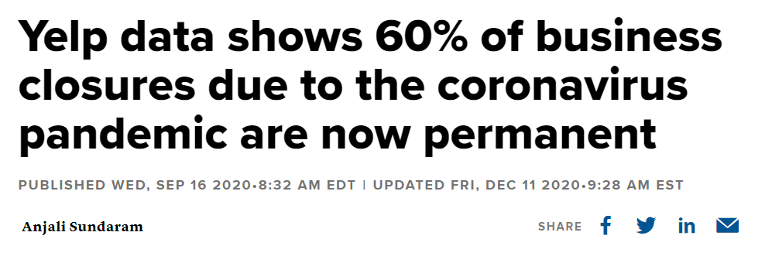
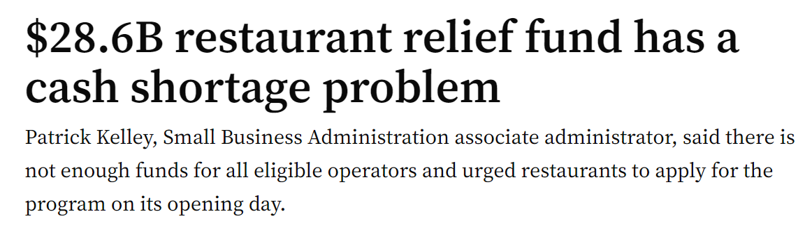
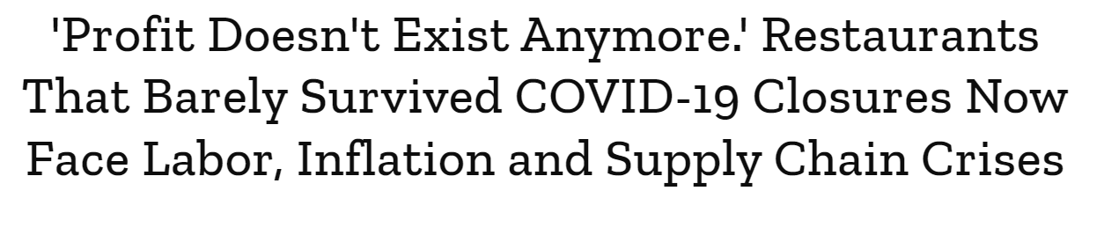
Background
Notes:
Restaurant closure is an issue that has been on many restaurant owner’s minds after the pandemic. Even in normal economic conditions, as many as 61% of independently operated restaurants fail within three years of opening, according to a widely cited 2005 analysis from Ohio State University researchers. The ongoing Covid-19 pandemic has made those odds infinitely worse. As you can see from the articles above, 60% of business closures due to coronavirus pandemic are now permanently closed, and those that are still open are barely surviving. Aid from the government is not enough to support all the restaurants that need help. With all the applicants applying, there was need of nearly triple the amount of funding available.

Slide 3
Research Question
In comparison to other characteristics of a restaurant, the experience of the customer creates a social impact. Although it is a relative term, customer satisfaction is reliant on the performance and availability of services. If customer satisfaction has an impact on the success and lifetime of a restaurant then customer satisfaction will be measured by extracting sentiment scores from the Yelp reviews of restaurants.
Notes:
Obviously the restaurant industry needs all the help it can get, so …

Slide 4
Variables (All Derived From Yelp Dataset)
Dependent Variable
Is the Restaurant Open or Closed?
Independent Variables
Customer Satisfaction (sentiment score)
Price Range
Ambience
Location
Yelp Stars
Does the restaurant offer takeout?
Does the restaurant have a delivery service?
Does the restaurant have free parking?
Does the restaurant have WiFi?
Notes:
Here are the characteristics that we are choosing to explore. All of these came straight from the yelp dataset.

Slide 5
How are we testing our research question?
Get the sentiment scores of our reviews using VADER and call it “customer satisfaction”
Compare sentiment scores against our dependent variable whether the restaurant is still open or not
Test the significance of our customer satisfaction variable with the other independent variables by running a logistic regression against the dependent variable
Rank which of our independent variables by importance in predicting restaurant closure.

Slide 6
Purpose
Both big restaurant corporations and small business owners can understand how market demands influence the success of their restaurant, and apply this research to their own restaurant. Policymakers can also understand what factors they should focus on when trying to help restaurants stay open during hard times like COVID-19.

Slide 7
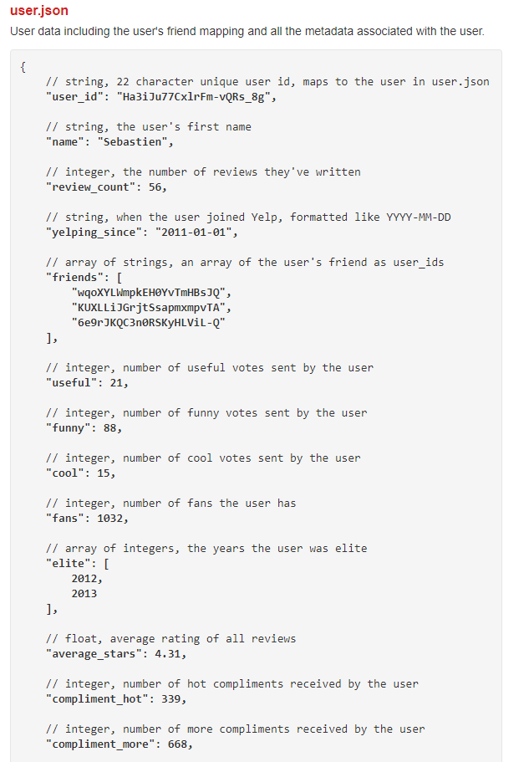
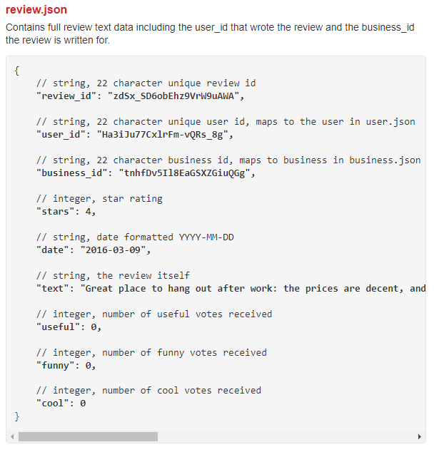
Dataset
Yelp Dataset

Slide 8
Why Yelp?
Yelp measures local business activity better than any government dataset since it is constantly being updated and has data that is geographically finer than county or ZIP code level that government agency data abides by (Glaeser, Kim, Luca 2017). In addition the information provided by the review has implications on the the social commerce, the social commerce provide cultural impact on the operating status of the business (Nakayama, M., & Wan, Y., 2019).

Slide 9
Exploratory Data Analysis
To better understand the limitations of our dataset

Slide 10
Dataset Stats
4696 reviews
1374 restaurants
Dataset released in 2018 (pre-pandemic)

Slide 11
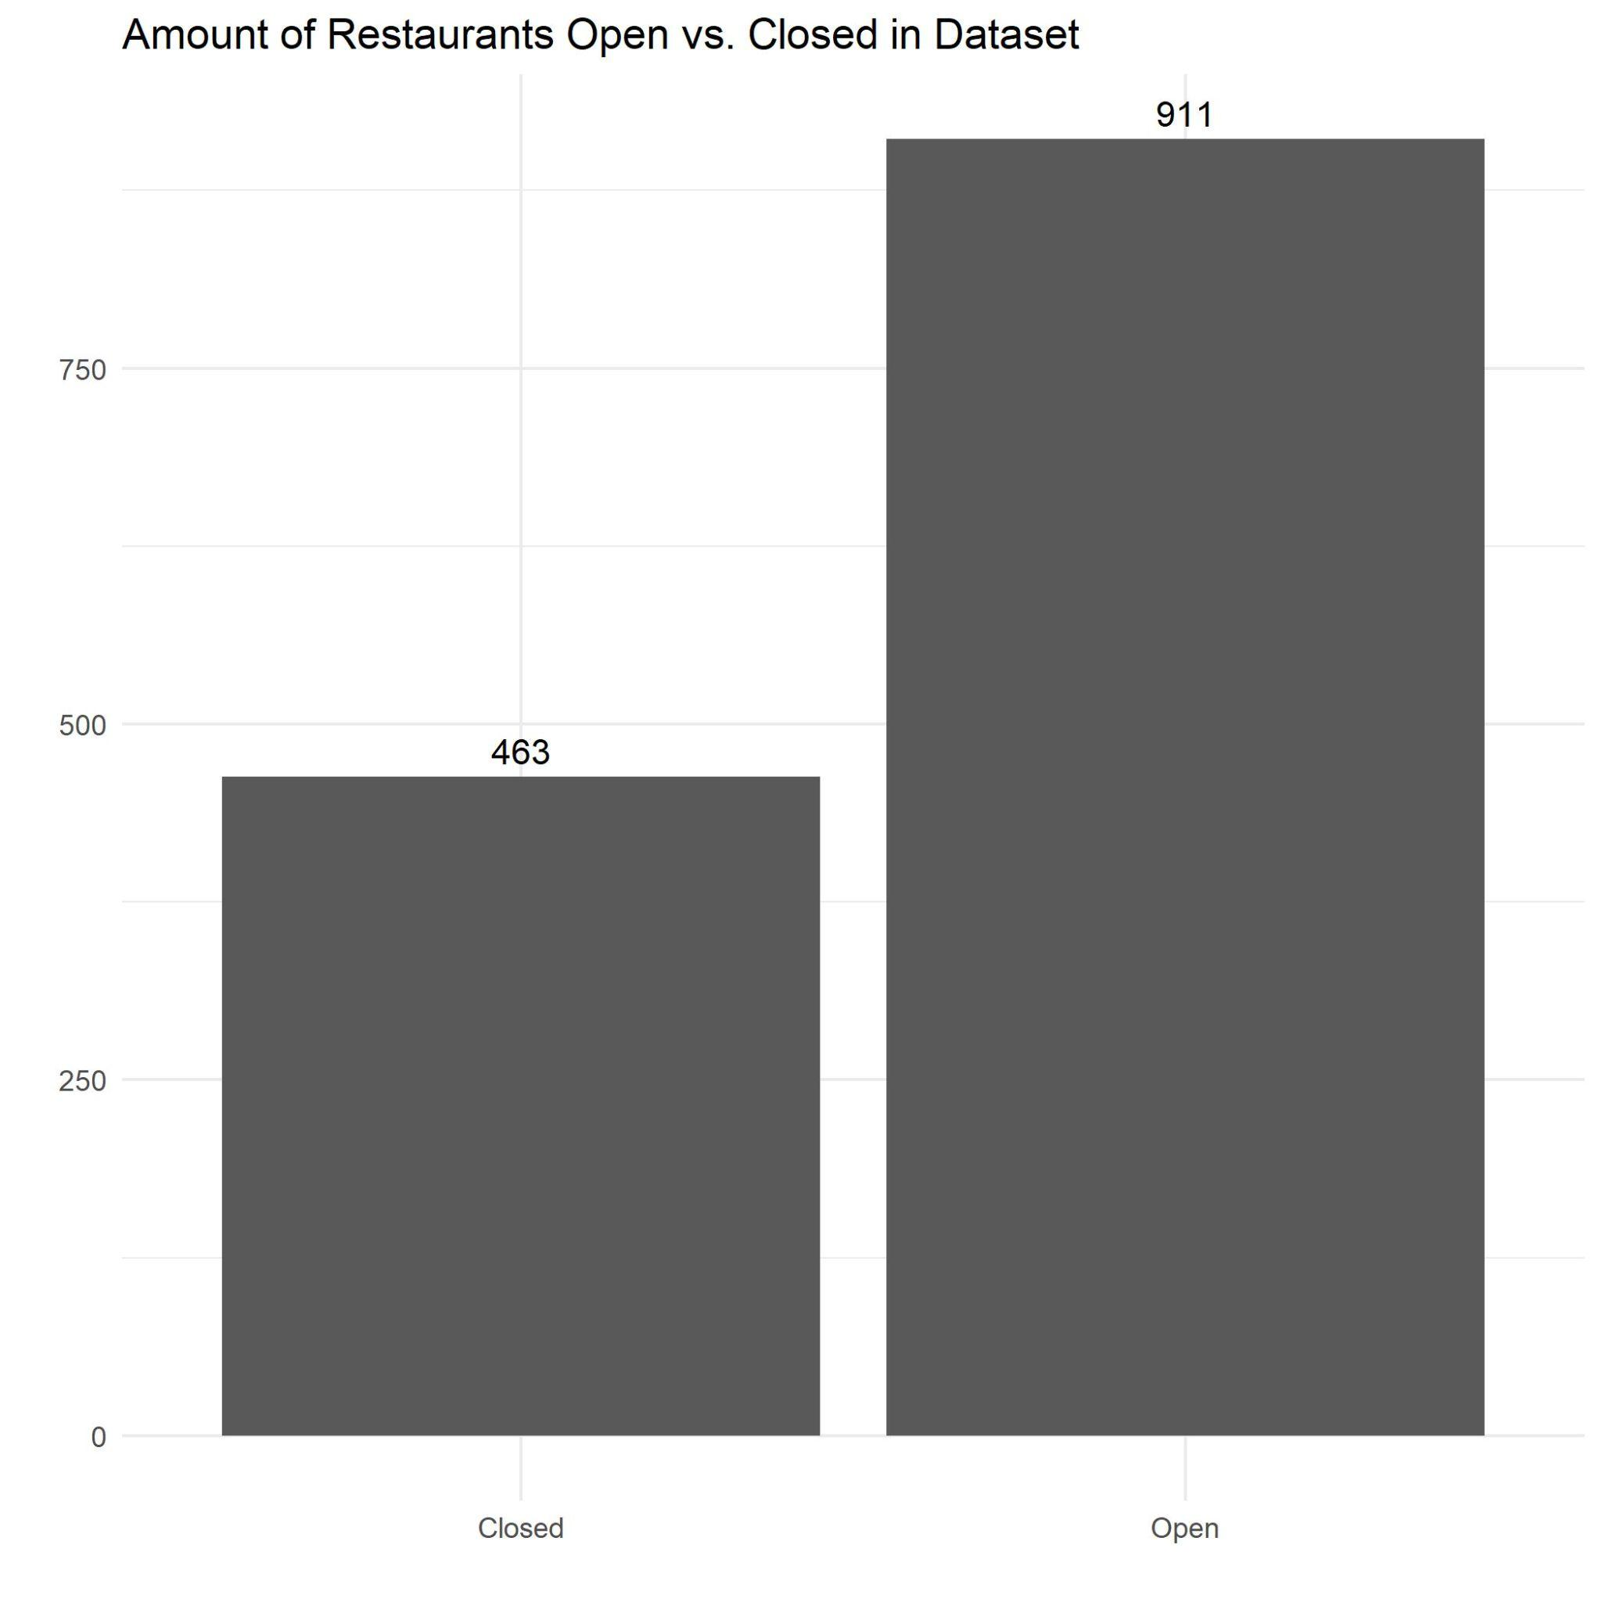
Notes:
There are roughly 75% open restaurants and 25% closed restaurants in our dataset. Ideally we would like a 50/50 distribution, but we felt that this was a good enough distribution that we didn’t need to oversample our data.

Slide 12
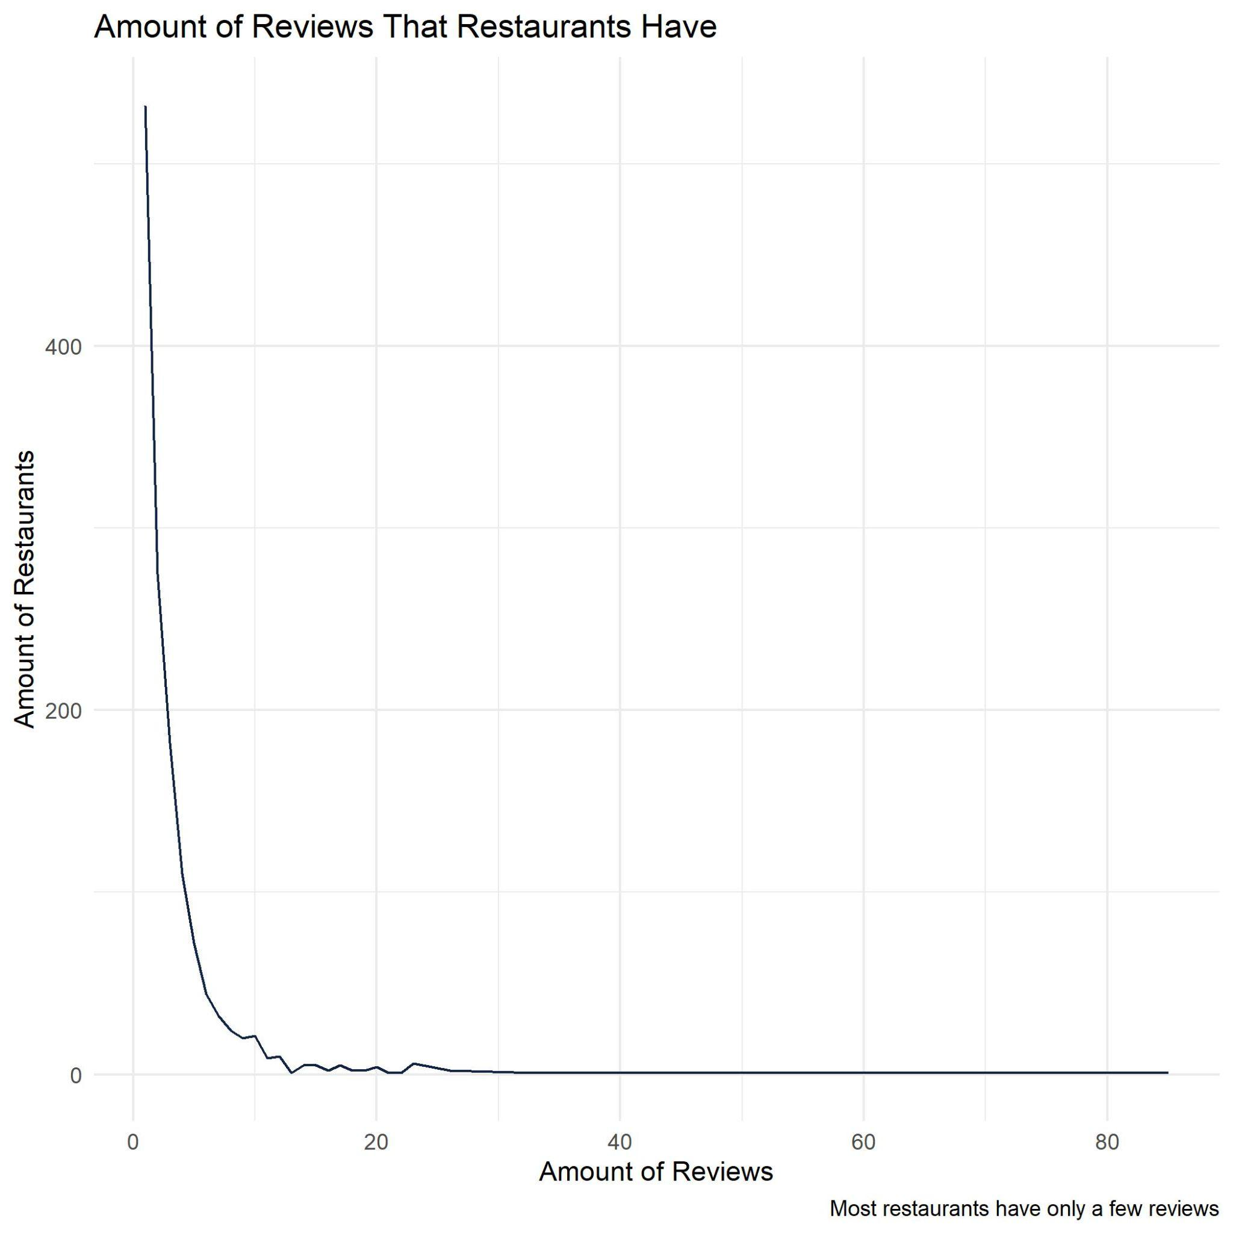
Notes:
Most restaurants have only a few reviews. We understand that only one or two reviews isn’t really enough to understand a consumer’s sentiment on a restaurant, and one person’s idea of a restaurant will determine the sentiment score of many of our restaurants. This is why we included the restaurant’s yelp star rating in our independent variables.

Slide 13
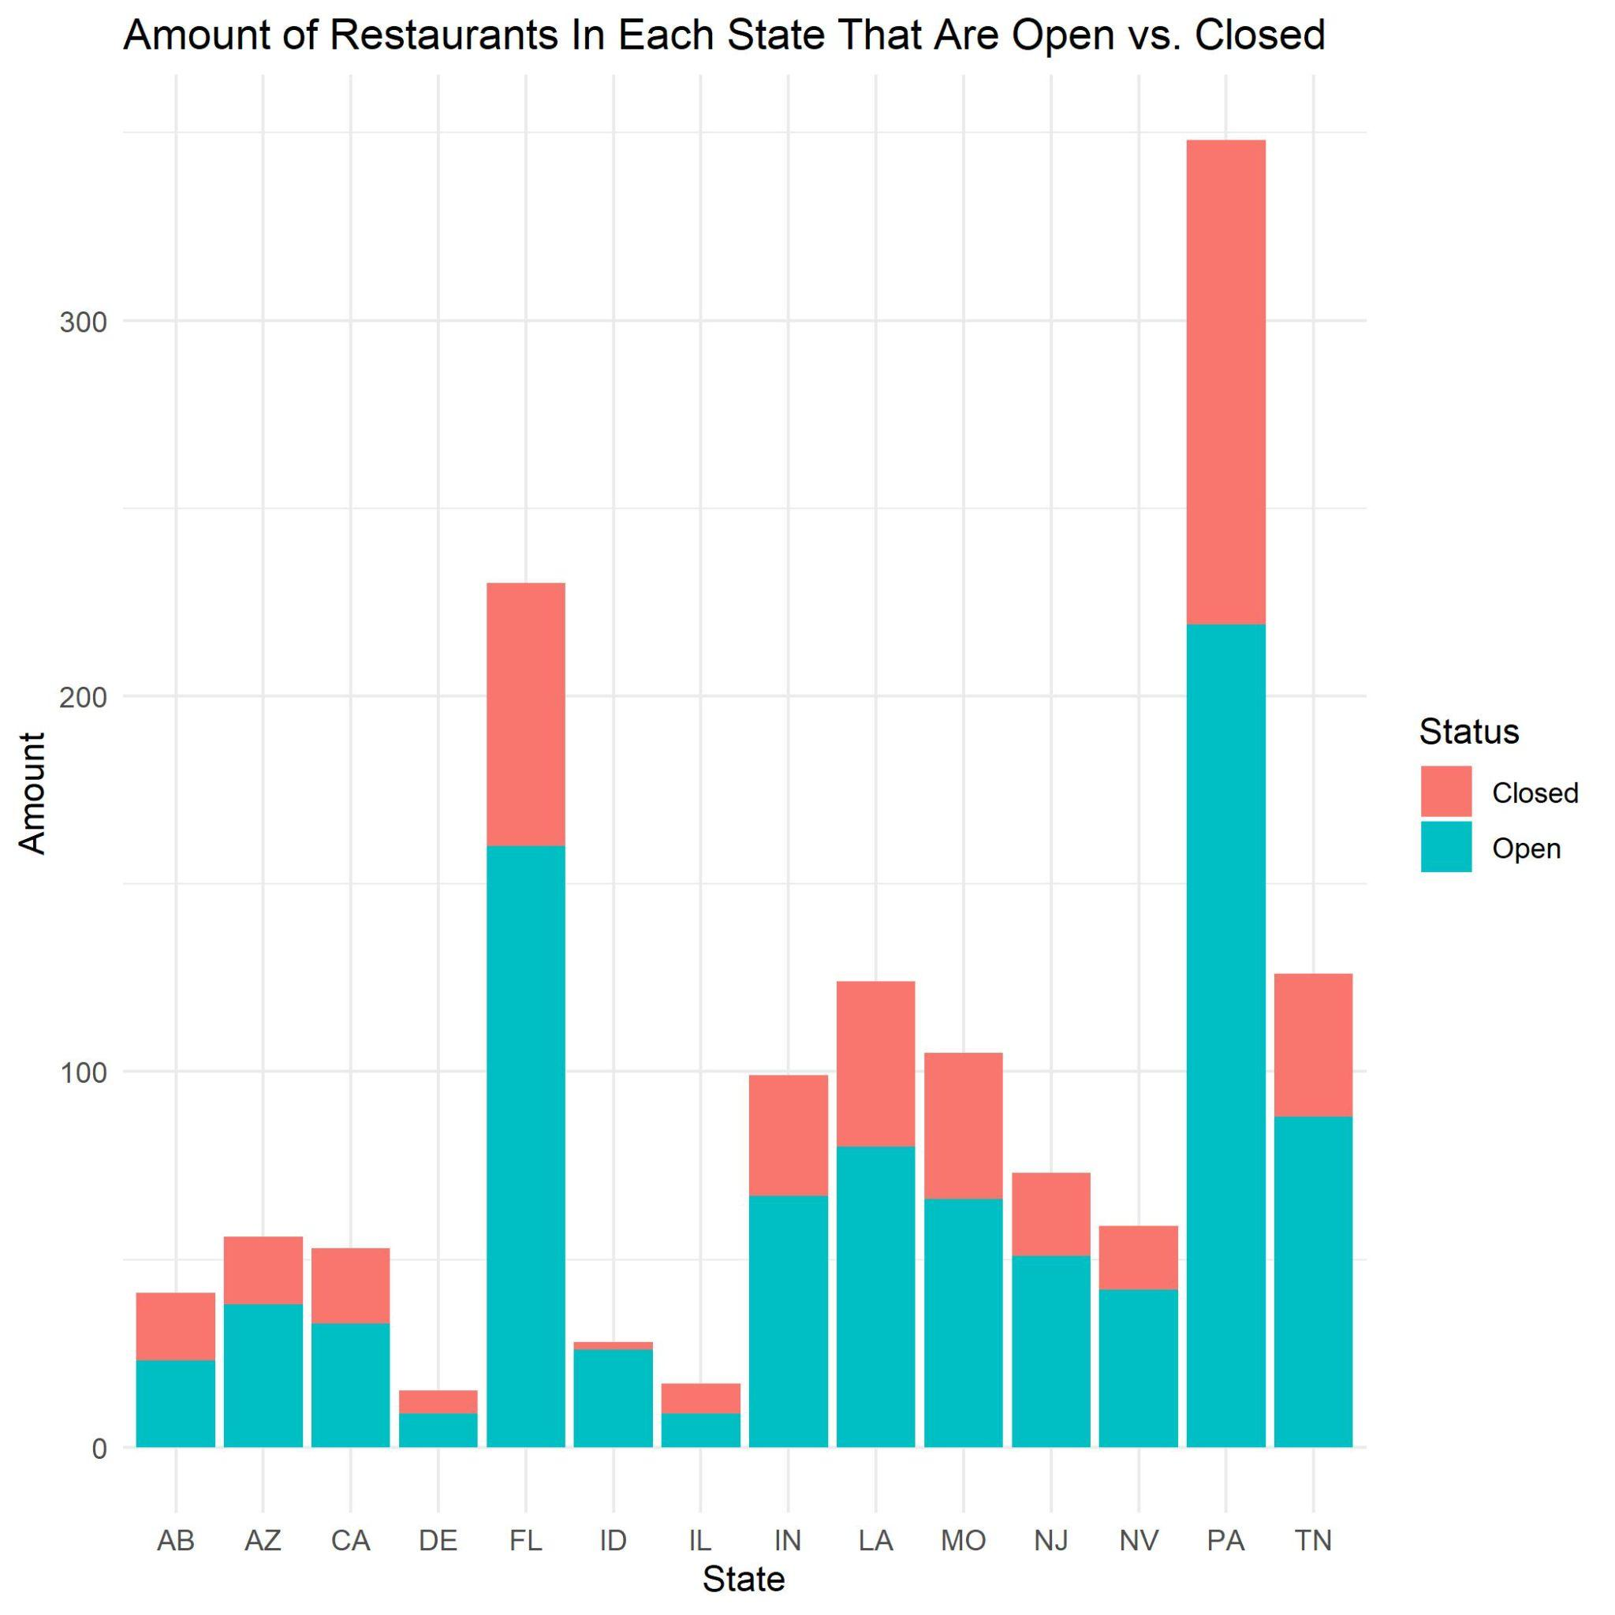
Notes:
Finally, we were curious about the location of these restaurants since regions can affect business success. It can be harder to keep a restaurant open in areas where rent is expensive, the minimum wage is higher, or there’s a lot of competition. That doesn’t necessarily seemed to be reflected in our data as seen in the bar graph, so we just have to keep in mind that our location variable might not be the strongest indicator of what’s going on in the real world. If we had a more balanced dataset based on location, we might see a stronger influence from the location variable.

Slide 14
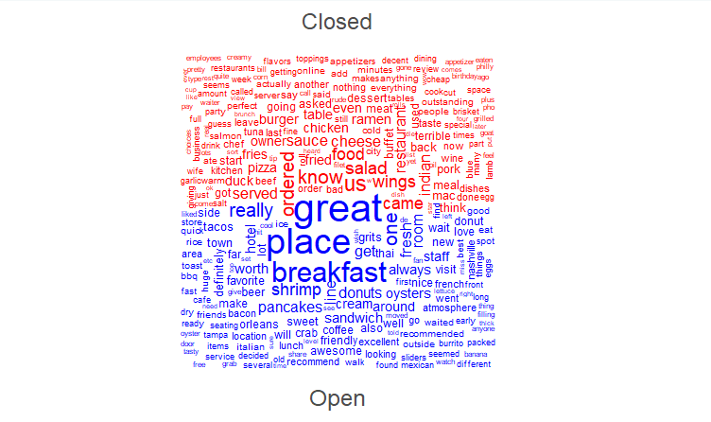
Word Cloud of Closed vs. Open Restaurant Reviews
Notes:
The word that stands out is ‘great’ for open restaurants. Does this mean that open restaurants tend to be greater than closed restaurants? Other than the word great, there doesn’t seem to be a difference between Open vs. Closed restaurants. It’s just a bunch of food words

Slide 15
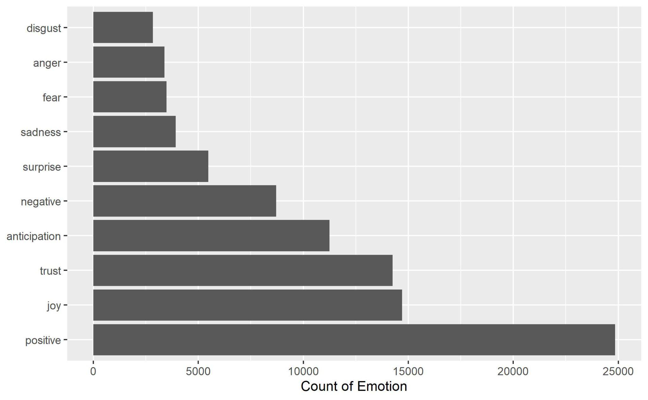
Count of Emotion on All Reviews
Notes:
We have a significantly higher amount of positive emotions in our dataset than negative. This tells us that our sentiment score will be biased towards positive words.

Slide 16
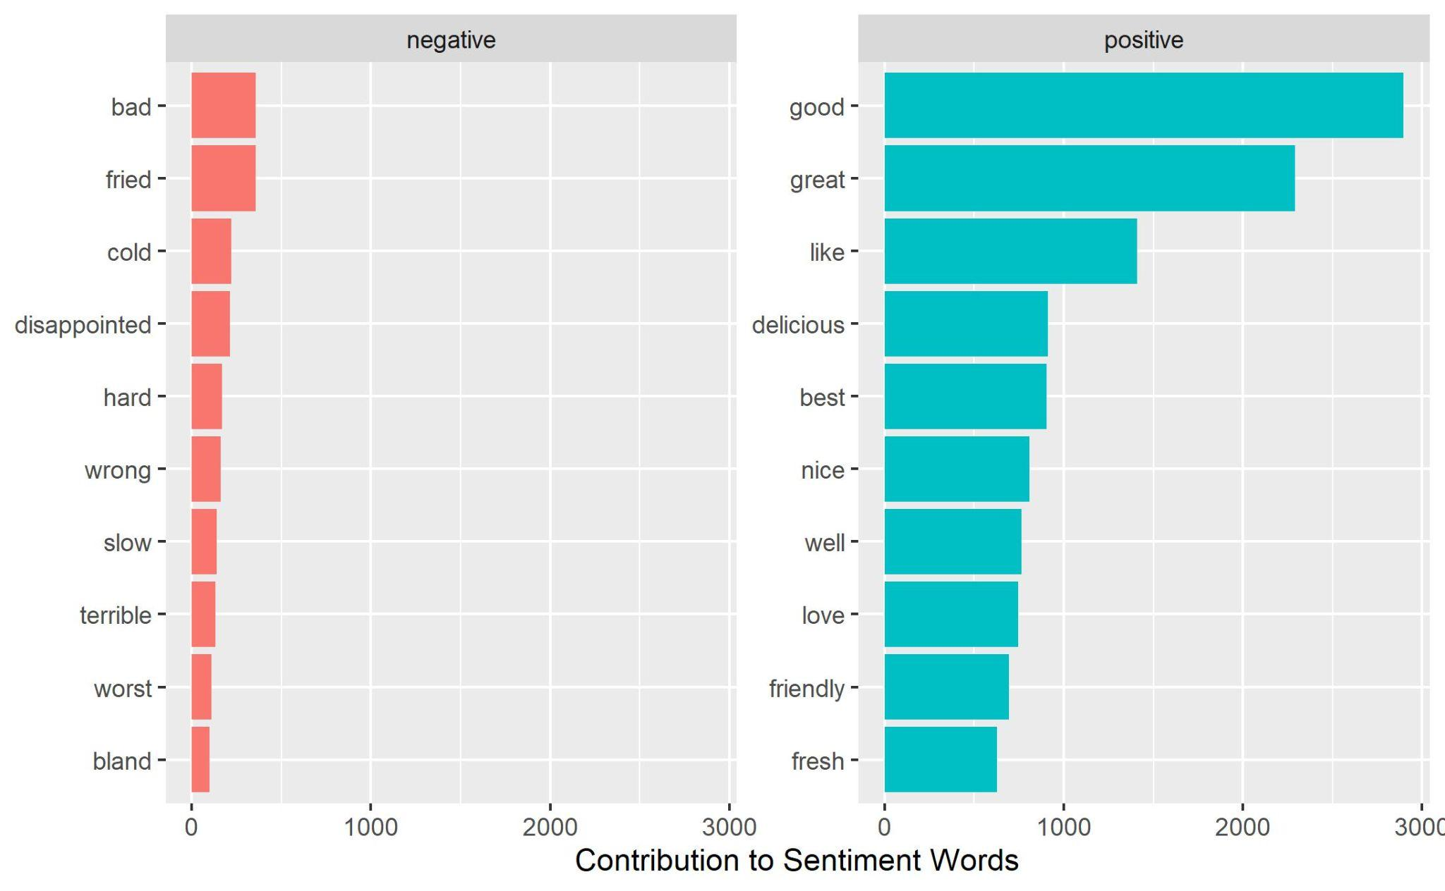
Most Popular Words Based on Sentiment
Notes:
Out of the negative and positive sentiments, here are the top 10 words. These words align to what we might think negative or positive reviews might contain. Negative reviews will have words like “cold, slow, terrible, and bland” while positive reviews will have words like “delicious, friendly, and fresh”.

Slide 17
Sentiment Analysis
Sentiment Score (Using VADER)
Notes:
Again, we used VADER because it is a library that is meant specifically for social media text. It wants you to give the text unprocessed so that it can use all that good stuff.

Slide 18
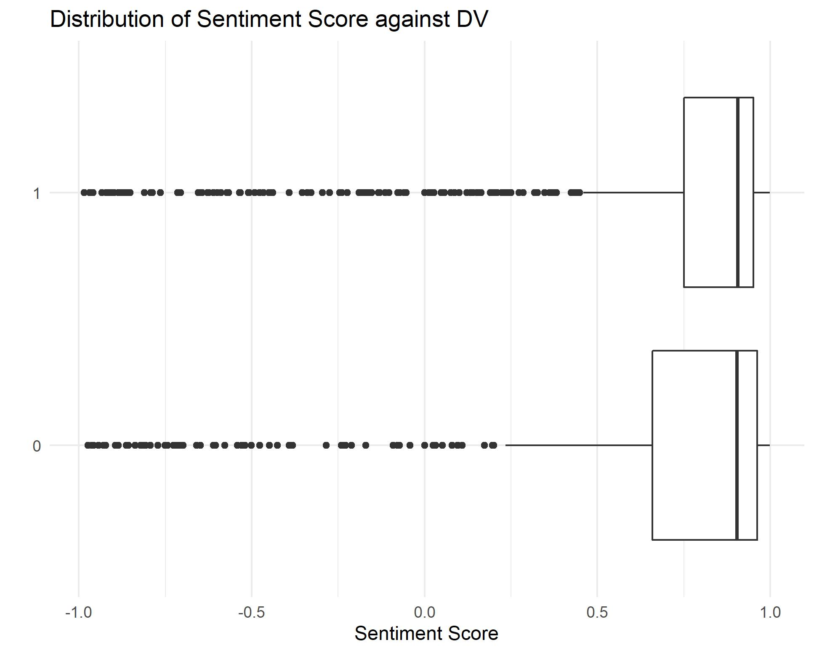
Sentiment Score Vs Dependent Variable
Notes:
We did our sentiment score showed us that restaurants that were open tended to have a more positive distribution of sentiment scores than restaurants that were closed. This meant that consumer satisfaction of a restaurant does have an influence on whether a restaurant stays open or closed. But do to the limitations of our data, we needed to compare it to yelp star rating.

Slide 19
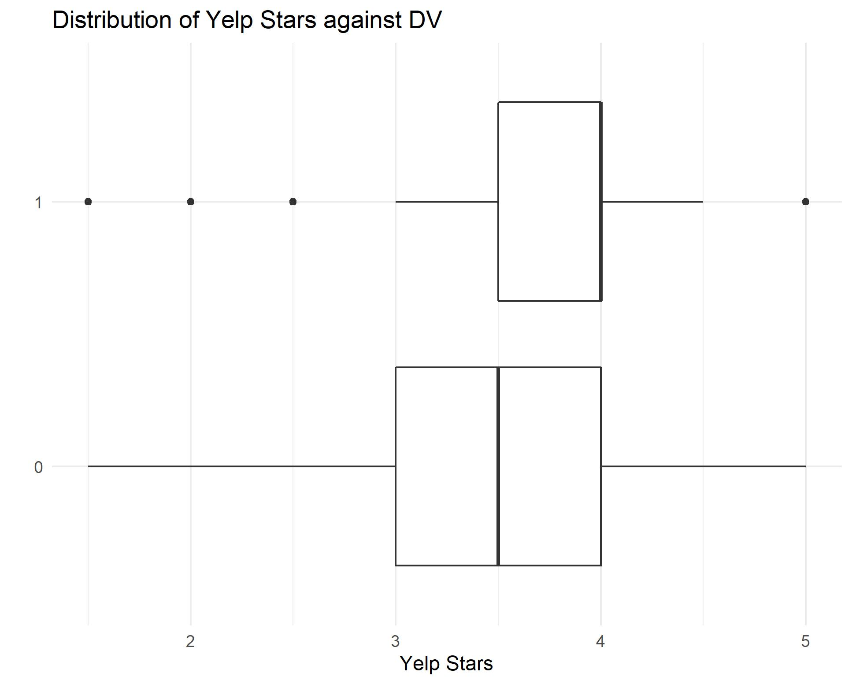
Compare to Yelp Star Rating Distribution
Notes:
This showed similar results to the sentiment score. But now we needed to see if this variable was even significant, so we performed a logistic regression.

Slide 20
Logistic Regression

Slide 21
Coefficients | Estimate | Std. Error | Z Value | P Value
Yelp Stars | 0.39152 | 0.09944 | 3.937 | 8.24e-05 ***
Delivery | 1.35208 | 0.12850 | 10.522 | < 2e-16 ***
Free Parking | 0.41544 | 0.12501 | 3.323 | 0.00089 ***
Price Range | -0.28659 | 0.11573 | -2.476 | 0.01327 *
Customer Sat. | 0.14931 | 0.14104 | 1.059 | 0.28976
Takeout | -0.36034 | 0.25051 | -1.438 | 0.15031
Touristy | 0.88322 | 0.51519 | 1.714 | 0.08646
WiFi | 0.10152 | 0.12456 | 0.815 | 0.41504
Trendy | -0.04981 | 0.24180 | -0.206 | 0.83680
Hipster | -0.20376 | 0.33205 | -0.614 | 0.53945
Upscale | 0.37376 | 0.51851 | 0.721 | 0.47101
Regions | -0.06160 | 0.05985 | -1.029 | 0.30333
(Intercept) | -1.16314 | 0.43317 | -2.685 | 0.00725 **

Slide 22
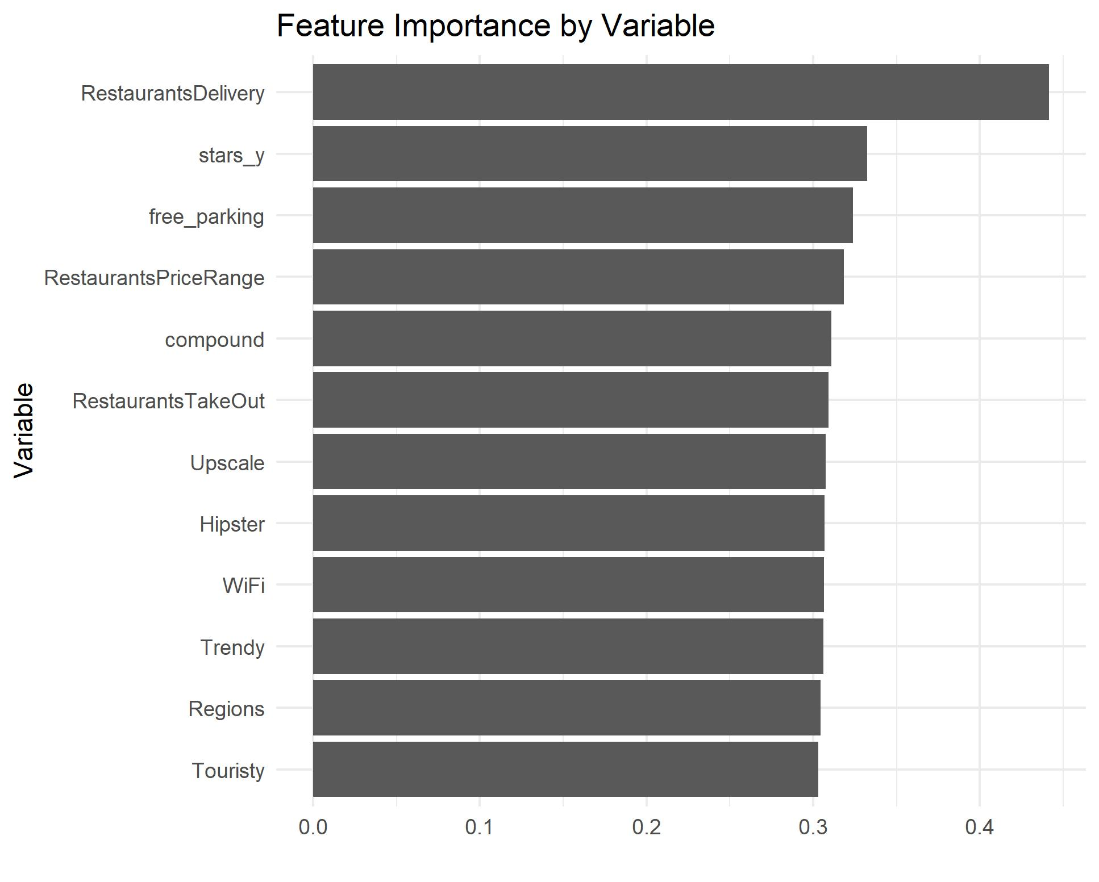

Slide 23
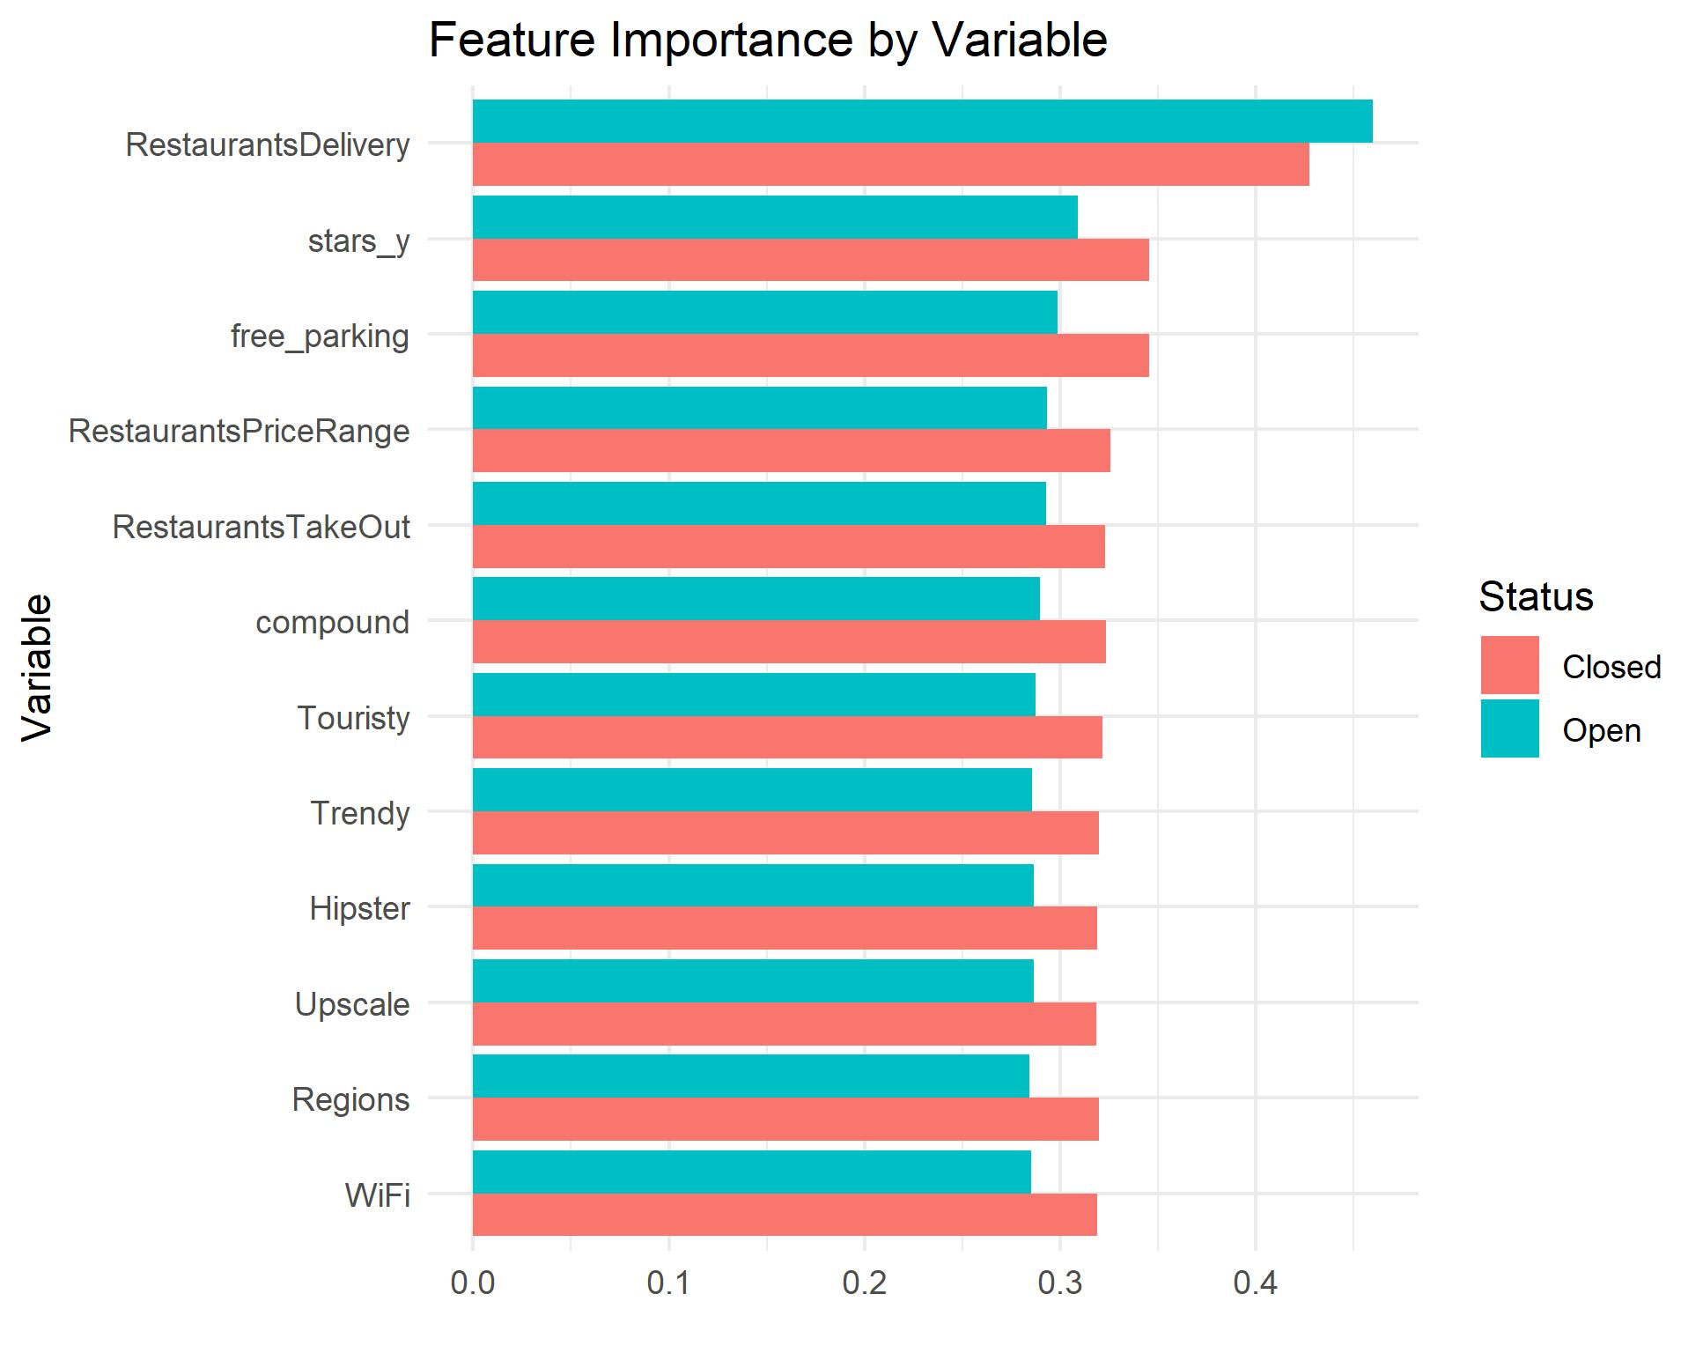

Slide 24
Conclusion
Our sentiment analysis shows that there is a correlation between consumer satisfaction
Due to the limitations in our data, we cannot conclude that consumer satisfaction is a significant predictor in determining whether a restaurant stays open or closed
Our regression showed that restaurants that have delivery, a high yelp rating, free parking, and a low price range are more likely to stay open

Slide 25
Closing Thoughts
Yelp reviews that indicated if a restaurant has good food and or if a restaurant was reliable to the consumers then, the restaurant would have good ratings (Kim, S.-H., Huang, R., & Kim, S., 2022). These ratings then are helpful in guiding other customers to purchase at the restaurant and support the business (Guerreiro, J., & Moro, S., 2017).
The review commentary on the establishment is helpful in understanding the cultural impact the restaurant has (Nakayama, M., & Wan, Y., 2019). Yelp allows for reviews to be categorized in helpfulness to ascertain a helpful perception (Nakayama, M., & Wan, Y., 2019). This is helpful considering the sentiment ambiance of the data.

